Slide 1



The Effects of Associative Direction on Judgment of Learning Reactivity
Nicholas P. Maxwell & Mark J. Huff
nicholas.maxwell@usm.edu | https://osf.io/8yvn3/

Slide 2
Introduction
JOLs may be reactive
Positive Reactivity – Increases in memory performance
Negative Reactivity – Costs to memory performance
Soderstrom et al. 2015
Mitchum et al. 2016

Slide 3
Introduction
Changed-Goal Hypothesis (Mitchum et al. 2016) – JOL reactivity occurs because participants focus on learning easy pairs at expense of difficult pairs
Positive reactivity for related pairs, negative reactivity for unrelated pairs
Strategic Relational Encoding – JOLs cause participants to implicitly engage in relational processing at encoding
Positive reactivity for related pairs, no reactivity for unrelated pairs

Slide 4
Overview of Experiments
Study
Arithmetic Filler Task
Recall
Experiment 1 – JOLs vs No-JOLs
Replicate previous findings showing reactivity for related pairs and no reactivity for unelated pairs
Experiment 2 – JOLs vs Relational Encoding vs Vowel Counting vs No-JOL
Relational encoding should mimic JOL reactivity for related pairs and should also boost recall of unrelated pairs
Experiment 3 – JOLs vs Frequency Judgments vs No-JOLs
Frequency judgments should display the same reactivity pattern as JOLs
40 forward (e.g., Credit-Card), backward (e.g., Card-Credit), symmetrical (e.g., King-Queen), and unrelated (e.g., Artery-Bronze) pairs were generated using the Nelson et al. (2004) free association norms.
Study lists were matched on FSG, length, concreteness, and frequency

Slide 5
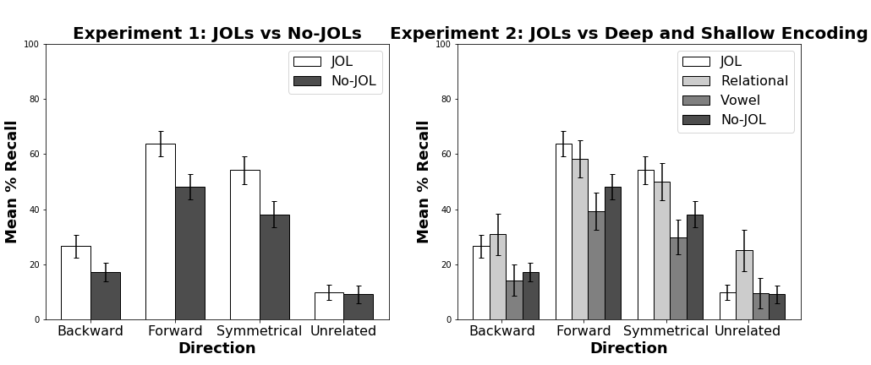
Results
*Bars indicate 95% CI

Slide 6
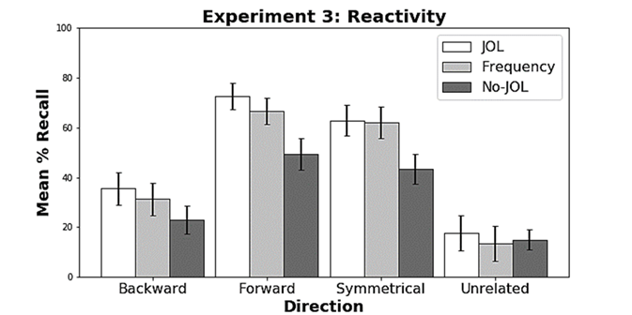
Results
*Bars indicate 95% CI

Slide 7
Conclusion
Strategic relational encoding provides a better explanation of JOL reactivity than the changed-goal hypothesis
It’s not the act of making a JOL that results in reactivity, but the relational encoding that occurs as a byproduct
JOLs aren’t a requisite for JOL reactivity!

